Slide 1


深度学习应用
——基于深度网络的视频动作识别

Slide 2

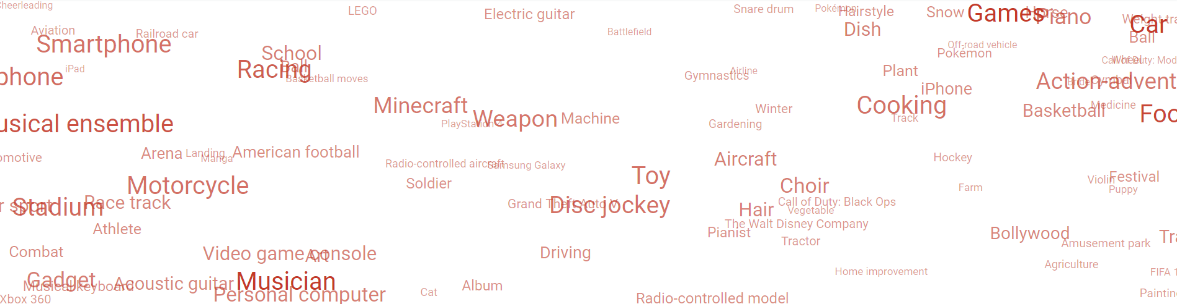
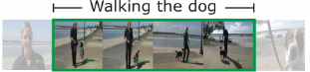
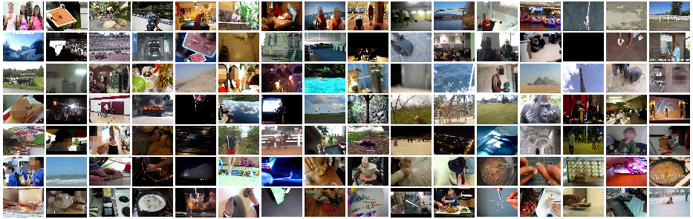
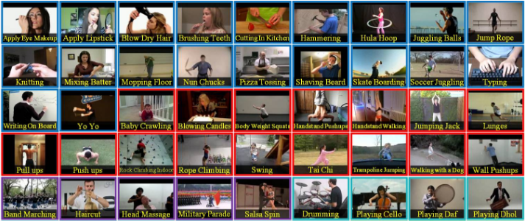
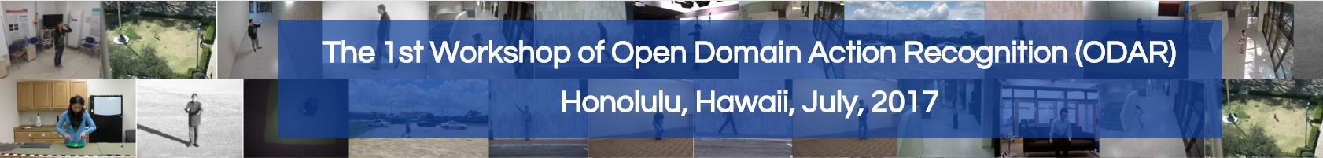
基于深度网络的视频动作识别
Youtube-8M
Thumos
Charades
ActivityNet
Youtube-8M
FCVID
ODAR
ACM-LSVC
UCF
ActivityNet
ODAR

Slide 3
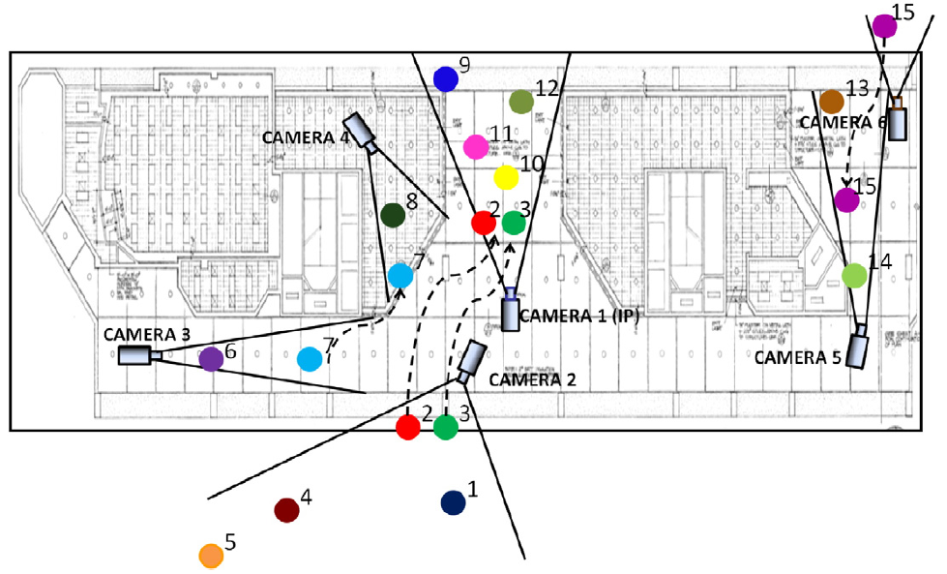
基于深度网络的视频动作识别
问题难点:
背景复杂、视角多变、运动模糊、冗余帧、动作主体

Slide 4
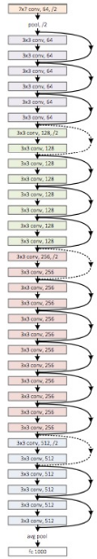
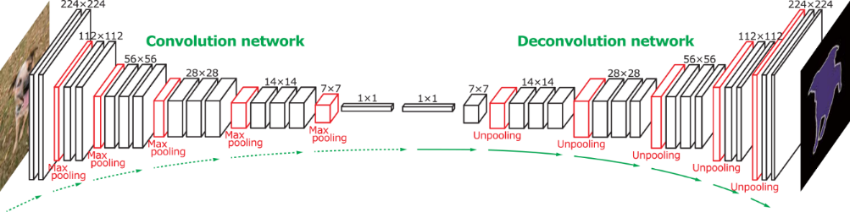
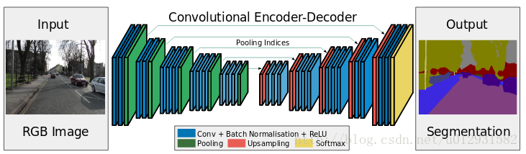
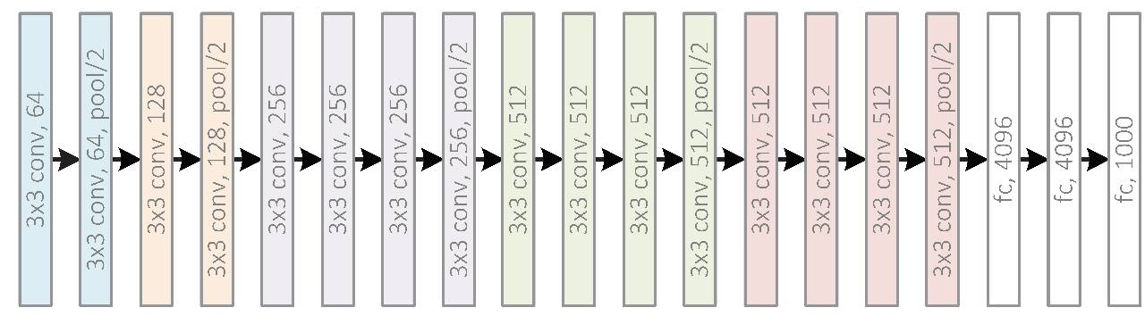

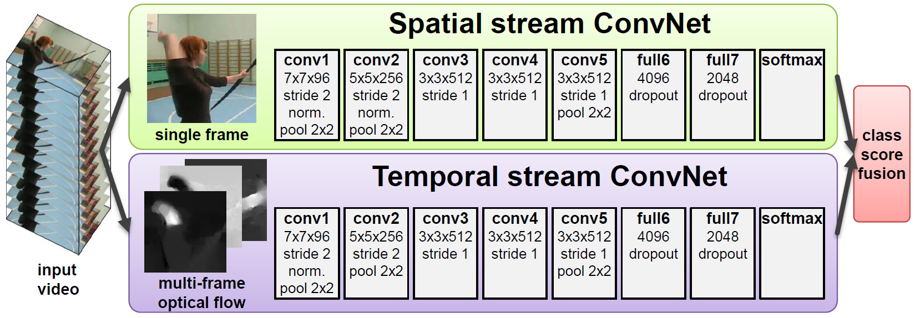
基于深度网络的视频动作识别

Slide 5
基于深度网络的视频动作识别
问题描述: 辨识视频主体的行为、动作 – Action Recognition
基本假定：视频动作类已知 --- 从动作识别到视频分类
应用领域:
防恐安防、人机交互、智能交通、智能监控、智能家居
主讲内容：
基于深度三维时空网络的视频动作识别.
基于深度双流时空网络的视频动作识别.

Slide 6
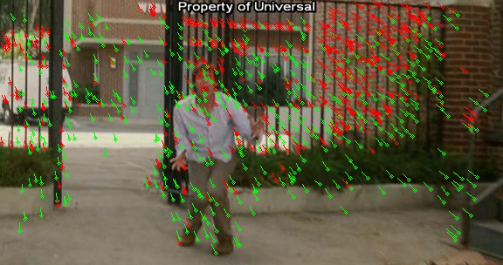
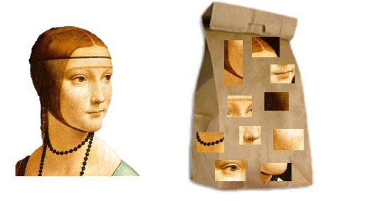
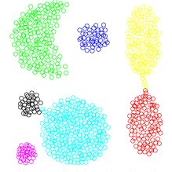
引 言
传统算法: 特征提取 + 特征编码 + 特征分类 = 模式识别

Slide 7
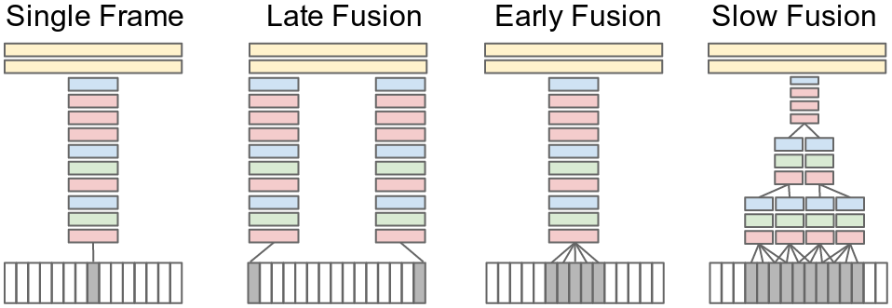
引 言
传统算法: 特征提取 + 特征编码 + 特征分类 = 模式识别
基本算法：单帧层面

Slide 8
引 言
传统算法: 特征提取 + 特征编码 + 特征分类 = 模式识别
基本算法：单帧层面
有何缺陷？

Slide 9
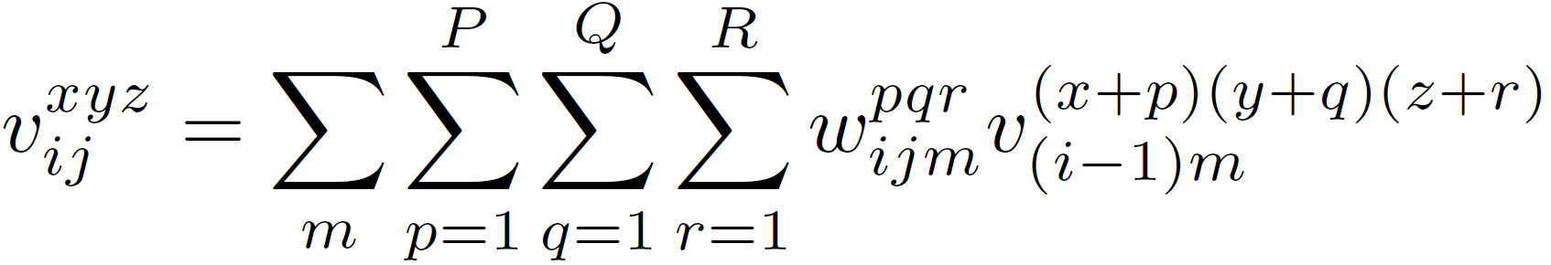

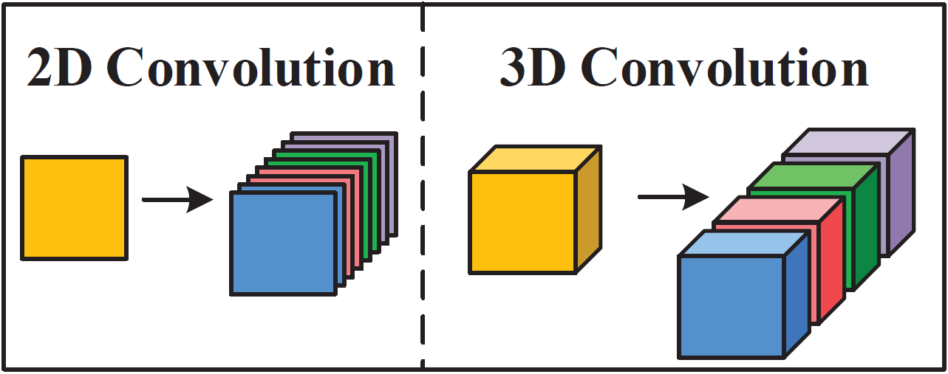
深度三维时空网络
二维卷积 vs. 三维卷积:
二维卷积强调空域卷积，三维卷积第三维为时域卷积，强调时空卷积。

Slide 10
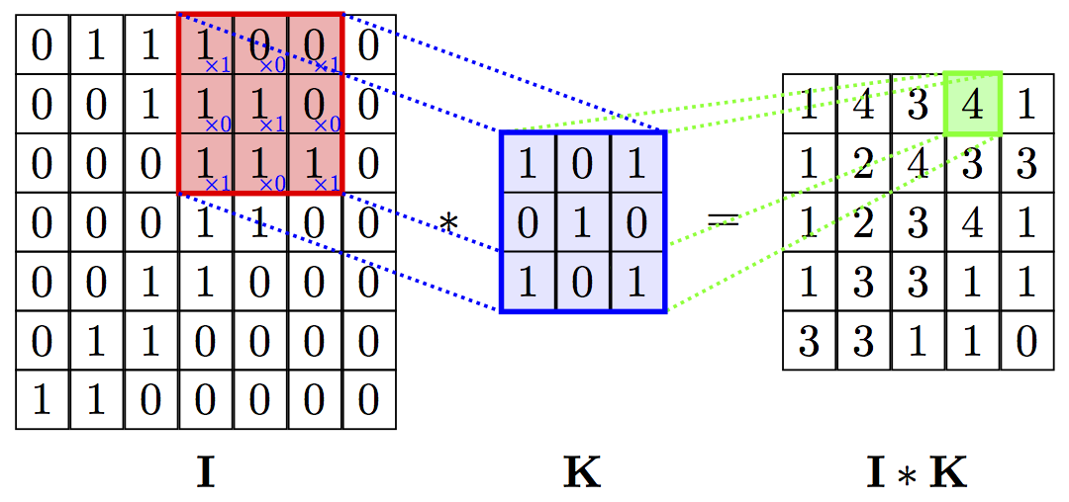
深度三维时空网络
二维卷积 vs. 三维卷积:
二维卷积强调空域卷积，三维卷积第三维为时域卷积，强调时空卷积。

Slide 11
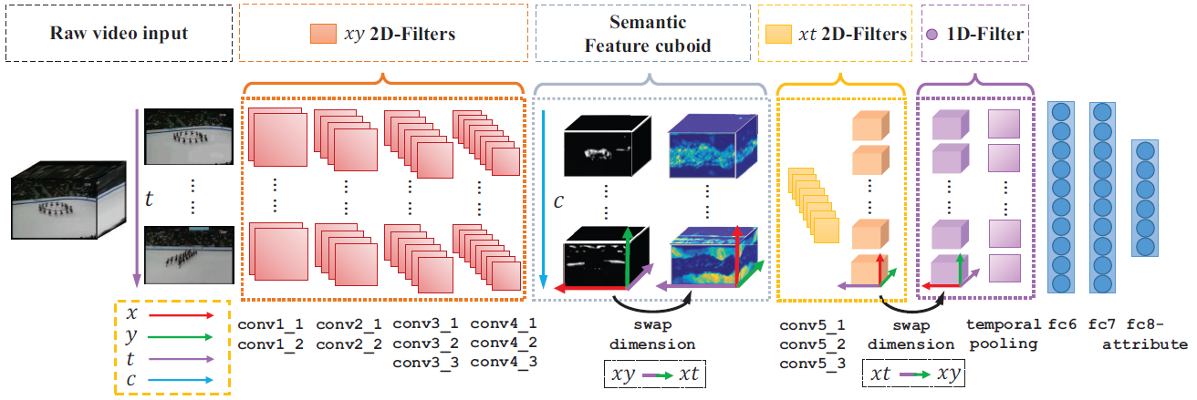
深度三维时空网络 – 分解
【2016 CVPR】Slicing Convolutional Neural Network for Crowd Video Understanding

Slide 12
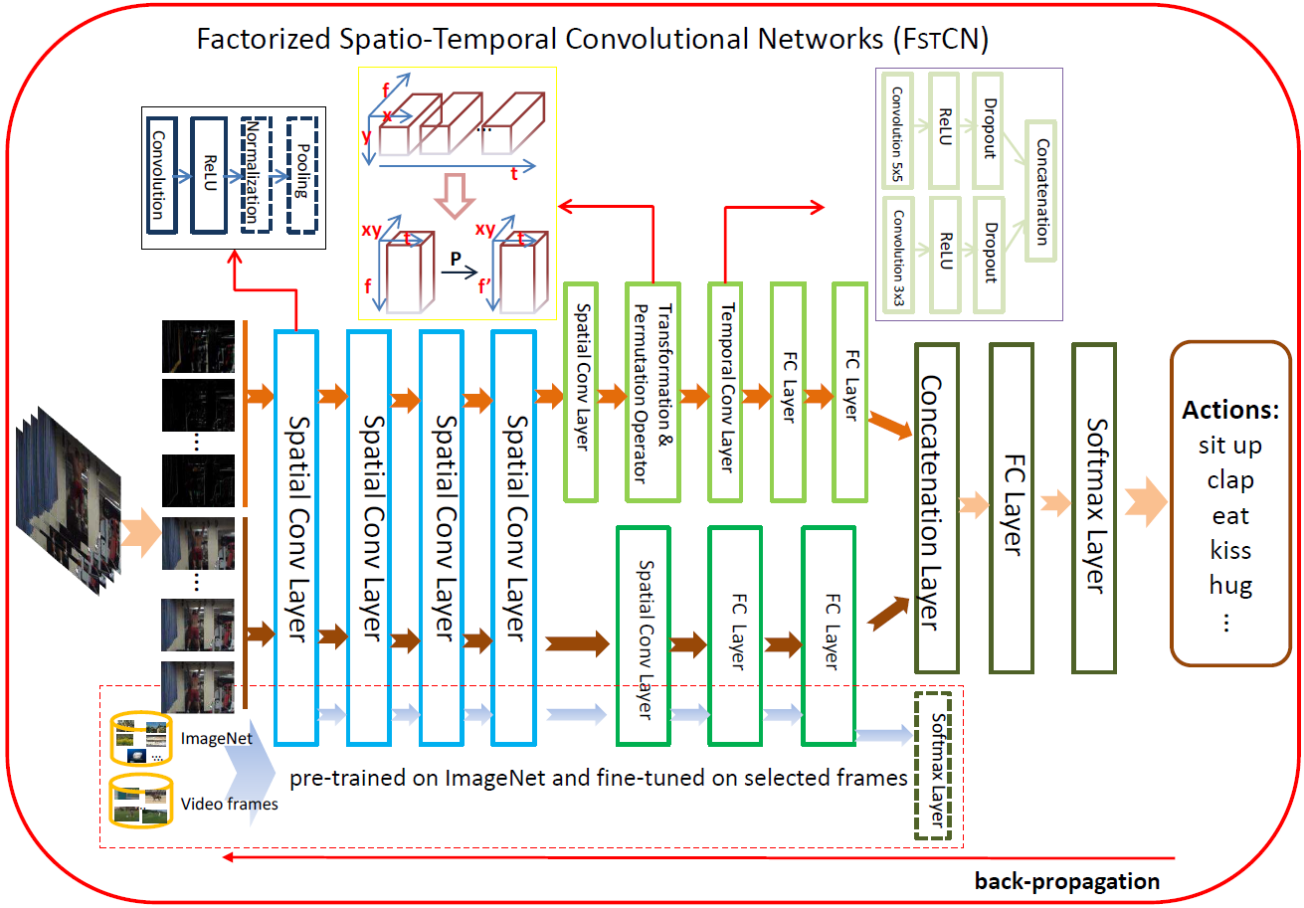
深度三维时空网络 – 分解
【2015 ICCV】Human Action Recognition using Factorized Spatio-Temporal Convolutional Networks

Slide 13
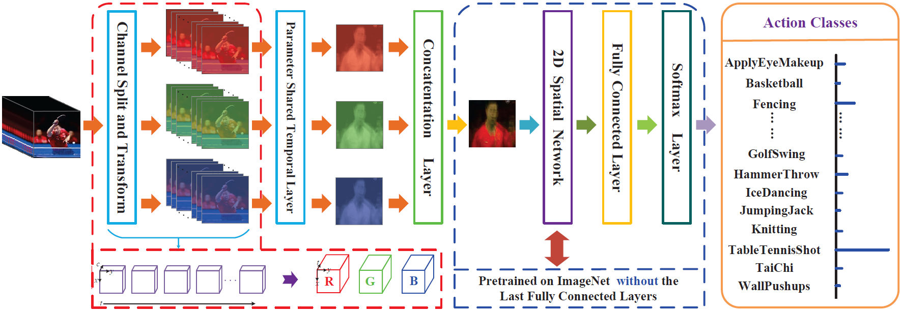
深度三维时空网络 – 分解
【2017 ICIP】Cascaded Temporal Spatial Features for Video Action Recognition

Slide 14
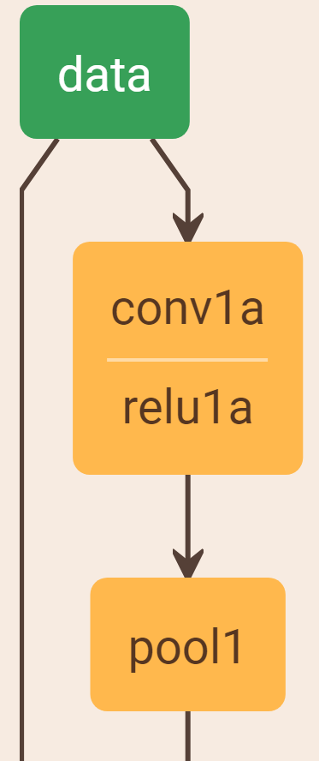
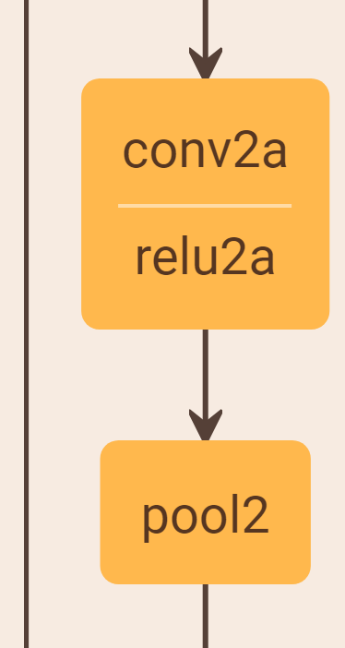
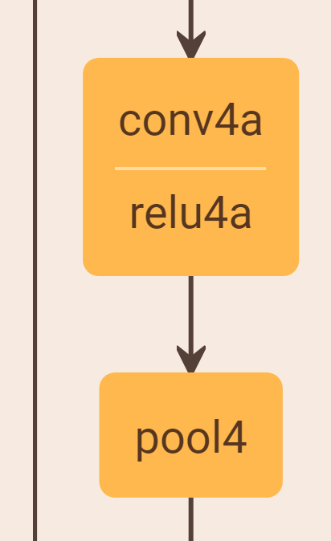
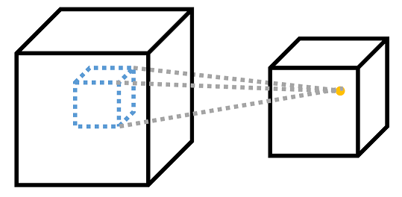
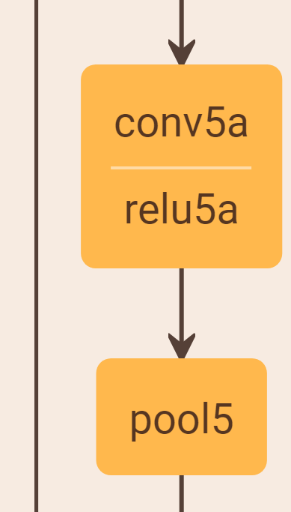
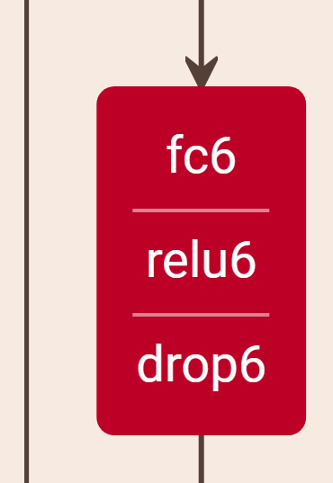
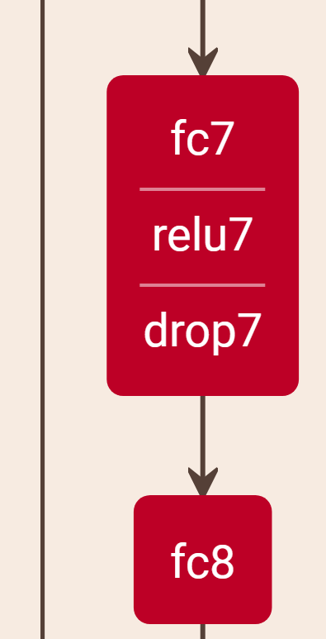
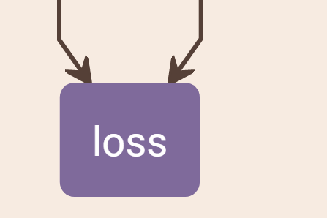
深度三维时空网络
layer
{ name: "data"
type: "VideoData"
top: "data"
top: "label"
transform_param {
mirror: true
crop_size: 112
mean_value: 128.0}
video_data_param {
source: train.lst"
batch_size: 24
shuffle: true
new_height: 128
new_width: 171
root_folder: ""
new_length: 8
show_data: false
use_image: true
sampling_rate: 2}
}
layer
{ name: "conv1"
type: "Convolution3D"
bottom: "data"
top: "conv1"
param
{ lr_mult: 1.0
decay_mult: 1.0 }
convolution3d_param
{ num_output: 64
bias_term: false
pad: 3
kernel_size: 7
kernel_depth: 3
stride: 2
temporal_stride: 1
weight_filler {
type: "gaussian"
std: 0.00999999977648}
temporal_pad: 1 }
}
layer
{ name: "fc8_new"
type: "InnerProduct"
bottom: "pool5"
top: “fc8_new”
param {
lr_mult: 1.0
decay_mult: 1.0 }
param {
lr_mult: 1.0
decay_mult: 0.0 }
inner_product_param {
num_output: 15
weight_filler {
type: "gaussian"
std: 0.00999999977648}
bias_filler {
type: "constant"
value: 0.0 } }
}
layer
{ name: "loss"
type: "SoftmaxWithLoss"
bottom: "fc8_new"
bottom: "label"
top: "loss“
}
【2015 ICCV】Learning spatiotemporal features with 3d convolutional networks

Slide 15
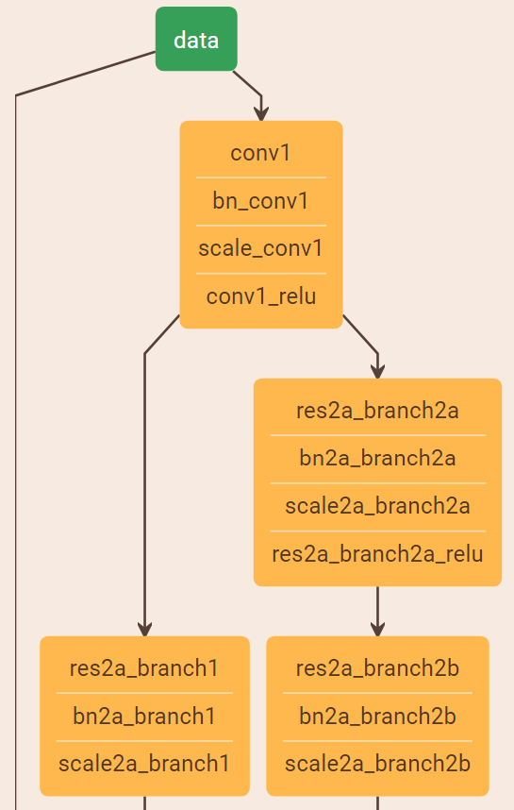
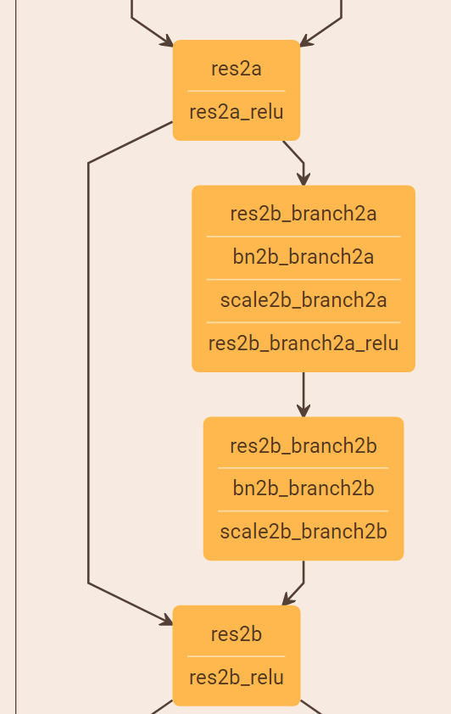

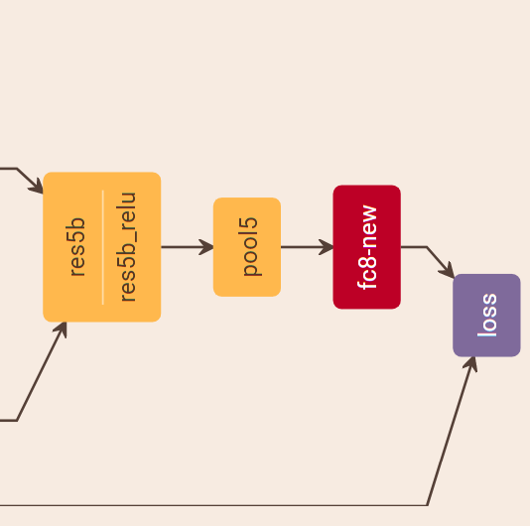
深度三维时空网络
【2017 arXiv】ConvNet Architecture Search for Spatio-temporal Feature Learning
【2015 ICCV】Learning spatiotemporal features with 3d convolutional networks

Slide 16
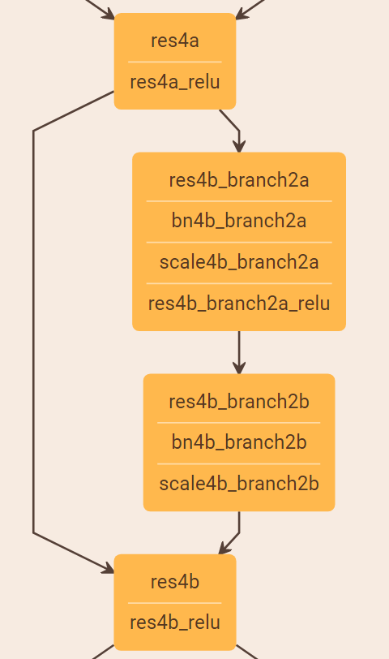
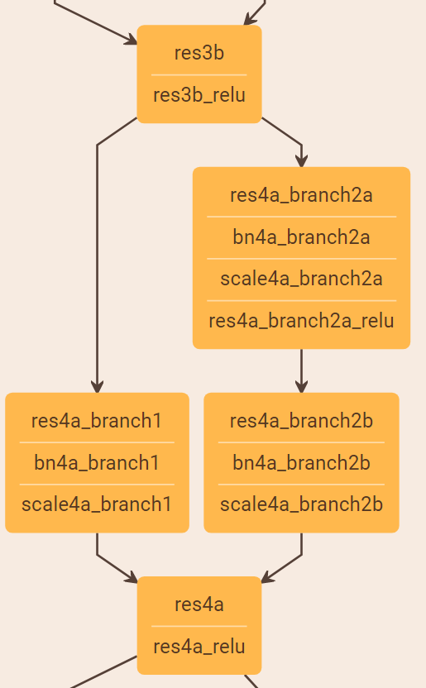
深度三维时空网络
卷积残差模块
Residual Block
恒等残差模块
Identity Block
【2017 arXiv】ConvNet Architecture Search for Spatio-temporal Feature Learning
【2015 ICCV】Learning spatiotemporal features with 3d convolutional networks

Slide 17
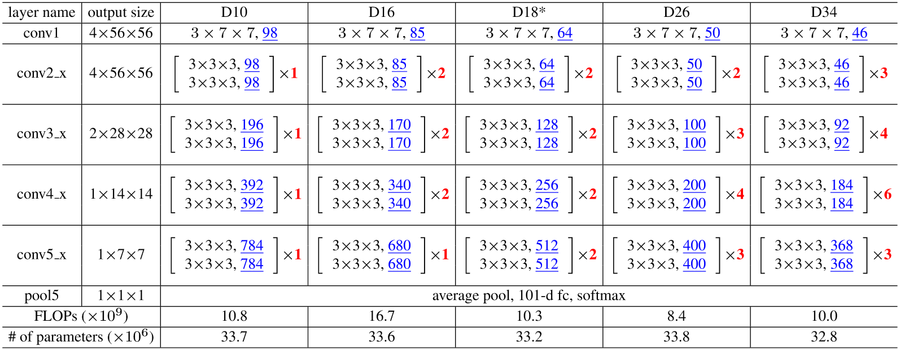
深度三维时空网络
【实例一】基于深度三维网络的动作识别 - Keras
【2017 arXiv】ConvNet Architecture Search for Spatio-temporal Feature Learning
【2015 ICCV】Learning spatiotemporal features with 3d convolutional networks

Slide 18
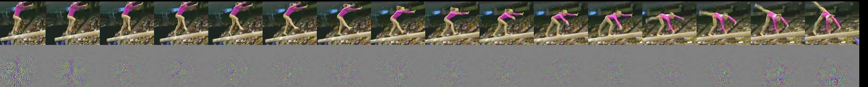
深度三维时空网络
特征图可视化 – Feature Map
【2015 ICCV】Learning spatiotemporal features with 3d convolutional networks

Slide 19
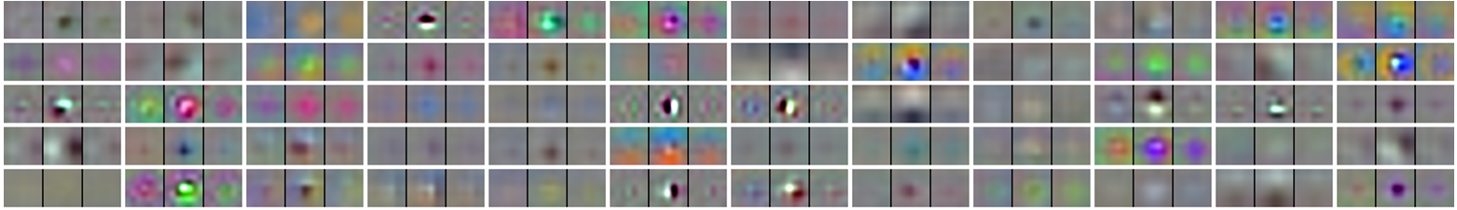
深度三维时空网络
特征图可视化 – Feature Map
卷积核可视化 – Convolution Kernel
【2017 arXiv】ConvNet Architecture Search for Spatio-temporal Feature Learning
【2015 ICCV】Learning spatiotemporal features with 3d convolutional networks

Slide 20
深度三维时空网络
特征图可视化 – Feature Map
卷积核可视化 – Convolution Kernel
中间层可视化 – Middle Layer
【2017 ICIP】Cascaded Temporal Spatial Features for Action Recognition
【2017 arXiv】ConvNet Architecture Search for Spatio-temporal Feature Learning
【2015 ICCV】Learning spatiotemporal features with 3d convolutional networks

Slide 21
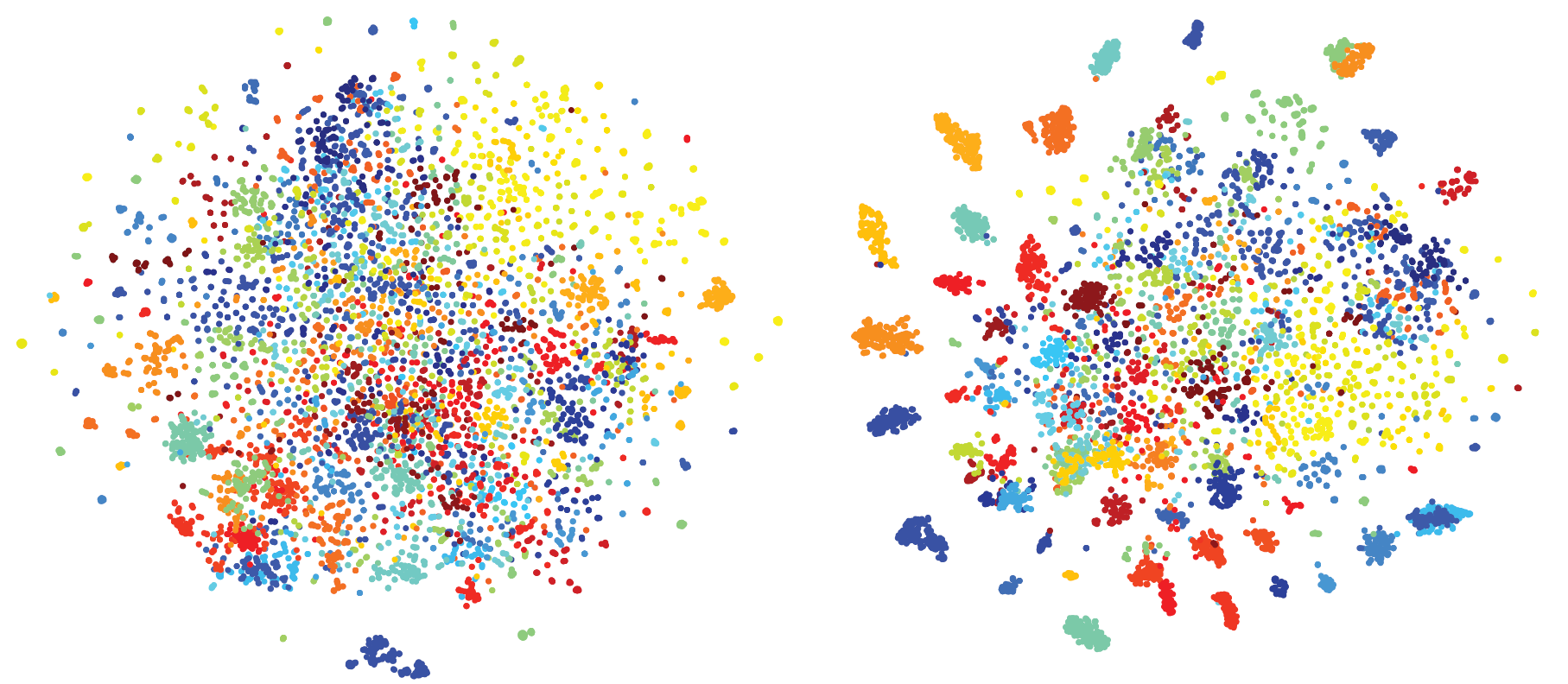
深度三维时空网络
特征图可视化
卷积核可视化
中间层可视化
全连接可视化
【2017 ICIP】Cascaded Temporal Spatial Features for Action Recognition
【2017 arXiv】ConvNet Architecture Search for Spatio-temporal Feature Learning
【2015 ICCV】Learning spatiotemporal features with 3d convolutional networks

Slide 22
深度三维时空网络
特征图可视化
意义？
卷积核可视化
中间层可视化
全连接可视化
【2017 ICIP】Cascaded Temporal Spatial Features for Action Recognition
【2017 arXiv】ConvNet Architecture Search for Spatio-temporal Feature Learning
【2015 ICCV】Learning spatiotemporal features with 3d convolutional networks

Slide 23
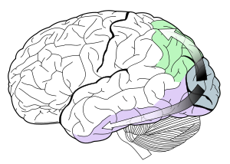
深度双流时空网络 - TwoStream
设计动机: 人脑启发
基本假定：视频动作类已知 --- 从识别到分类
背侧流 – 运动识别
残差连接
腹侧流 – 物体辨识
[1] M. A. Goodale and A. D. Milner. Separate visual pathways for perception and action. Trends in Neurosciences, 15(1):20–25, 1992.
[2] Richard T Born. Segregation of global and local motion processing in primate middle temporal visual area. Nature, 357(6378):497–499, 1992.

Slide 24
深度双流时空网络
腹侧流 – 物体辨识
背侧流 – 运动识别
【2015 NIPS】Two-Stream Convolutional Networks for Action Recognition in Videos

Slide 25
深度双流时空网络
什么是光流(optical flow):
光流是空间运动物体在观测成像平面上的像素运动的瞬时速度。
基本假设：
相邻帧之间的亮度恒定
相邻帧之间物体的运动比较“微小”
保持空间一致性

Slide 26
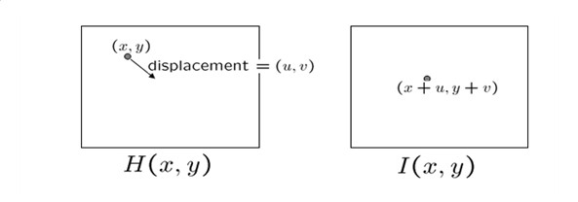
深度双流时空网络
什么是光流:
光流是空间运动物体在观测成像平面上的像素运动的瞬时速度。
光流场是运动场在二维图像平面上的投影

Slide 27
深度双流时空网络
设计动机: 人脑启发
基本假定：视频动作类已知 --- 从识别到分类
背侧流 – 运动识别
残差连接
腹侧流 – 物体辨识
[1] M. A. Goodale and A. D. Milner. Separate visual pathways for perception and action. Trends in Neurosciences, 15(1):20–25, 1992.
[2] Richard T Born. Segregation of global and local motion processing in primate middle temporal visual area. Nature, 357(6378):497–499, 1992.

Slide 28
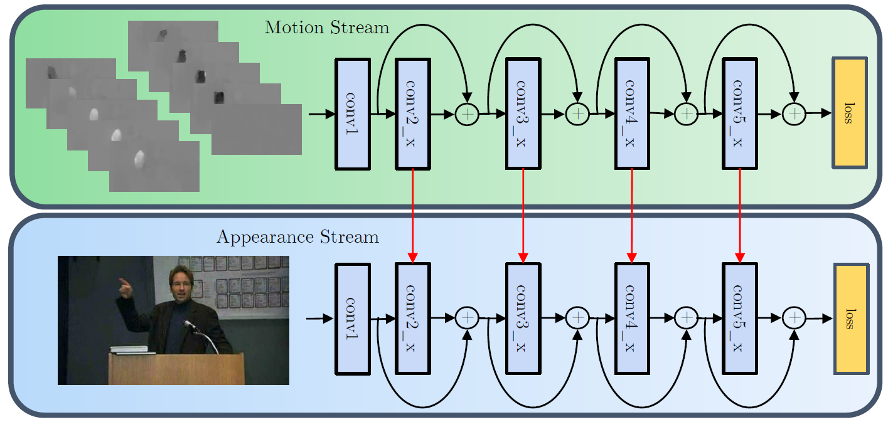
深度双流时空网络
腹侧流 – 物体辨识
残差连接 –Residual Connection
背侧流 – 运动识别
【2016 NIPS】Spatiotemporal Residual Networks for Video Action Recognition

Slide 29
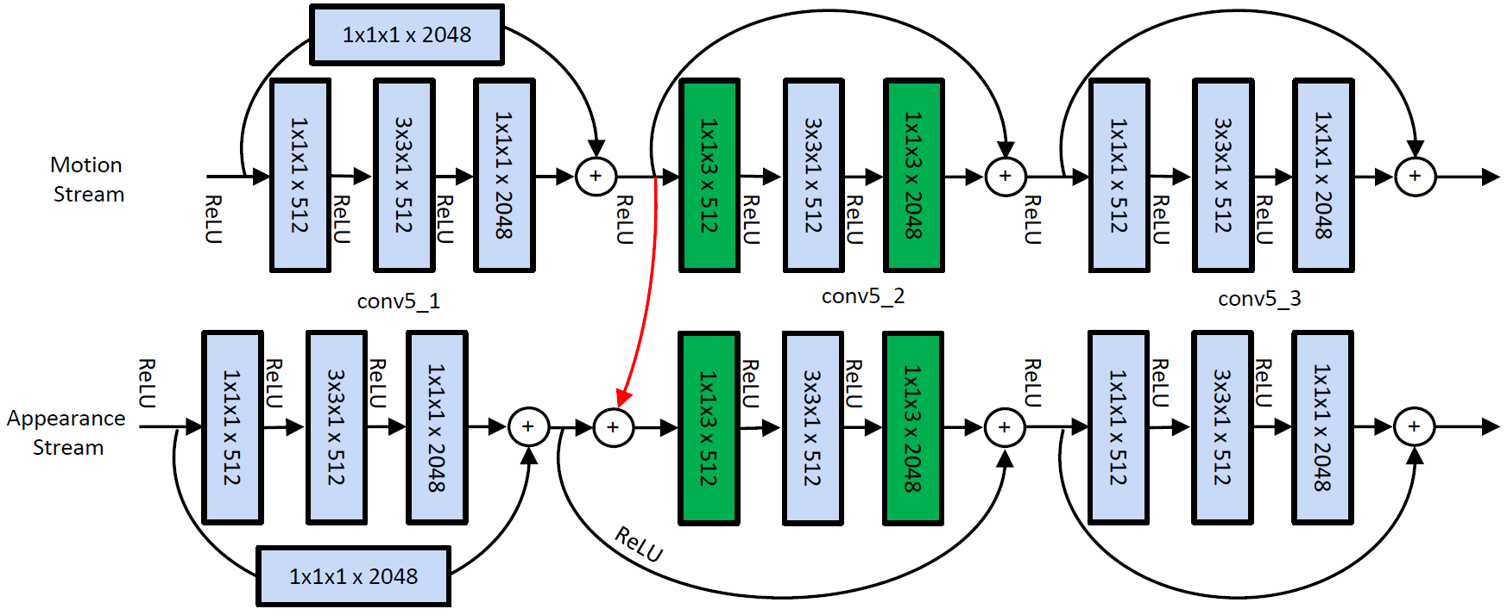
深度双流时空网络
前向、反向传播
【2016 NIPS】Spatiotemporal Residual Networks for Video Action Recognition

Slide 30
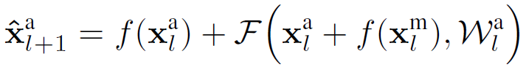
深度双流时空网络
前向、反向传播
【2016 NIPS】Spatiotemporal Residual Networks for Video Action Recognition

Slide 31
深度双流时空网络
前向、反向传播
【2016 NIPS】Spatiotemporal Residual Networks for Video Action Recognition

Slide 32
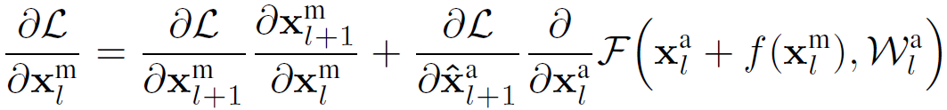
深度双流时空网络
前向、反向传播
【2016 NIPS】Spatiotemporal Residual Networks for Video Action Recognition

Slide 33
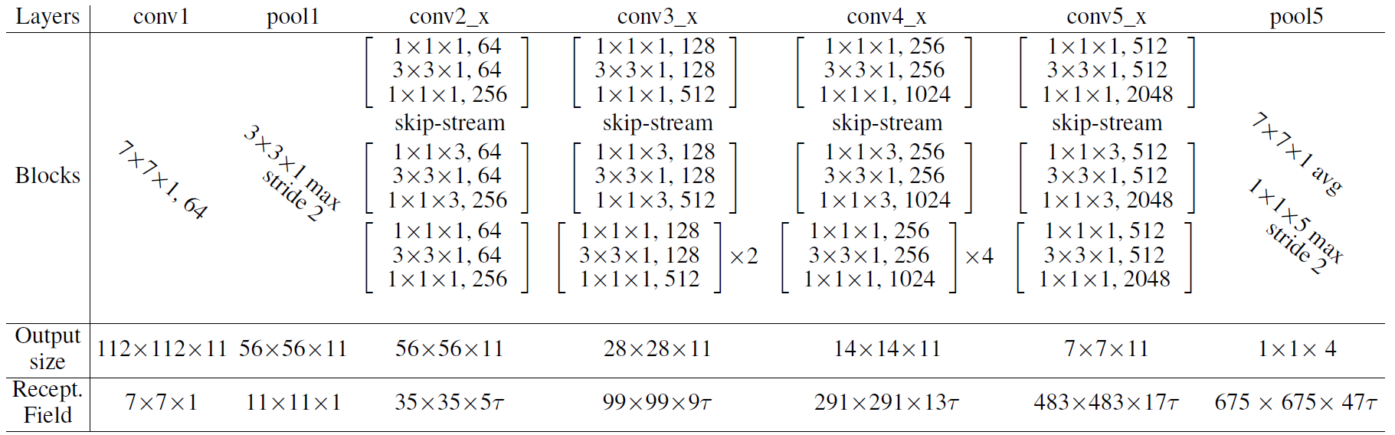
深度双流时空网络
【实例二】基于深度双流网络的动作识别 - Keras
【2015 NIPS】Two-Stream Convolutional Networks for Action Recognition in Videos
【2016 NIPS】Spatiotemporal Residual Networks for Video Action Recognition

Slide 34
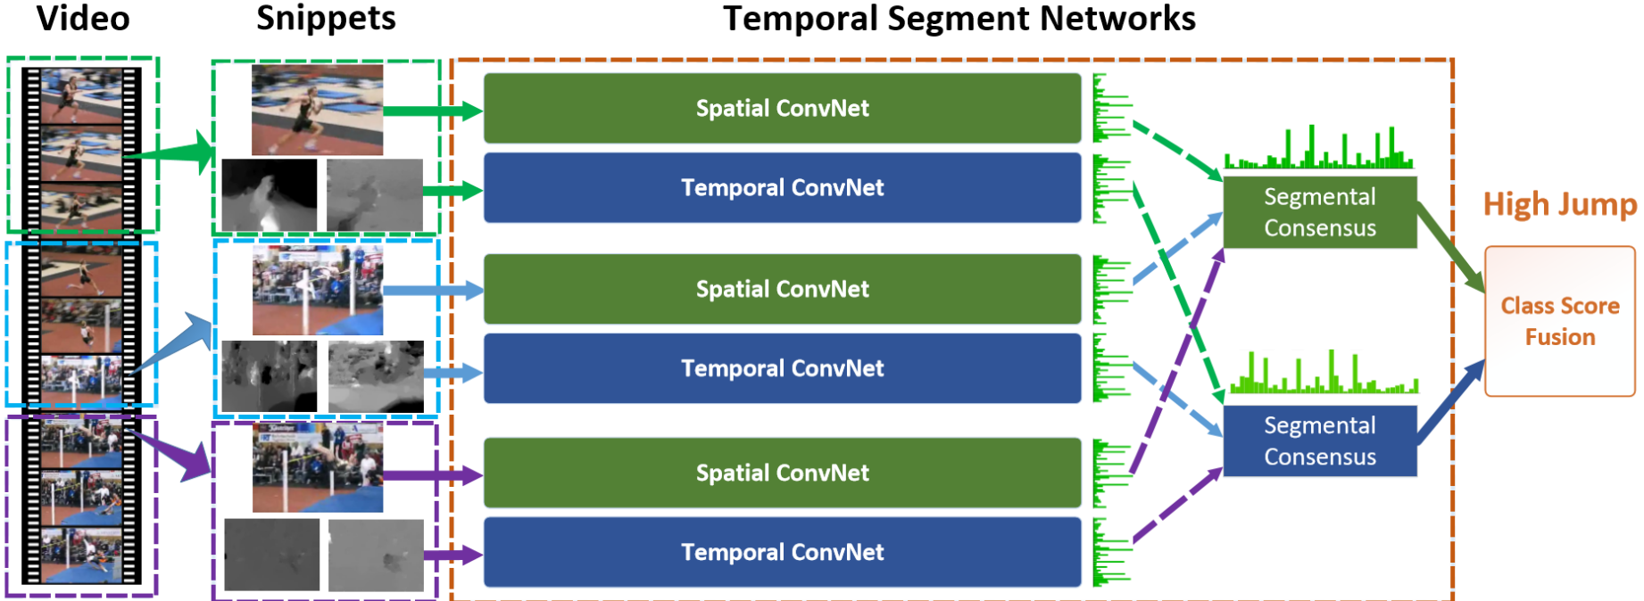
深度双流时空网络
【2016 ECCV】TSNs: Towards Good Practices for Deep Action Recognition

Slide 35
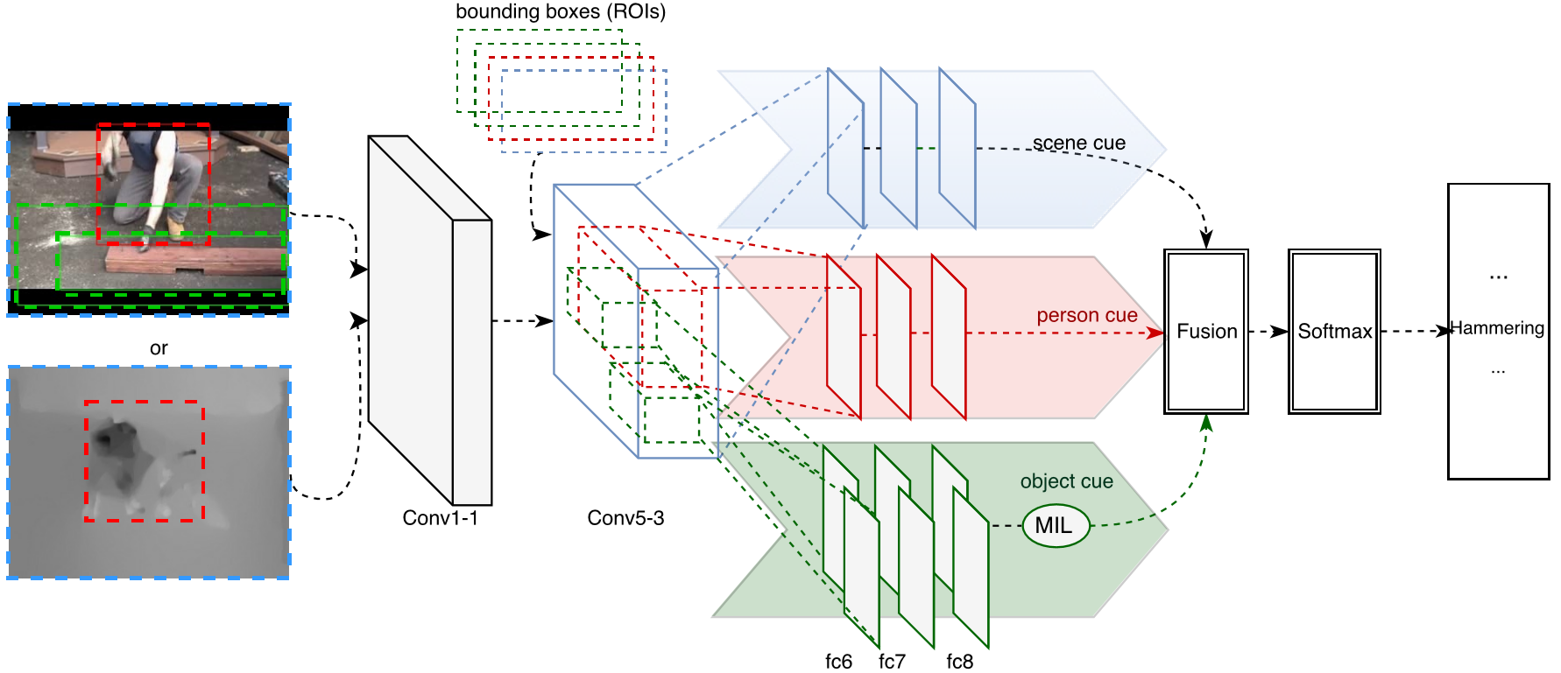
深度双流时空网络
【2016 BMVC】Two-Stream SR-CNNS for Action Recognition in Videos

Slide 36
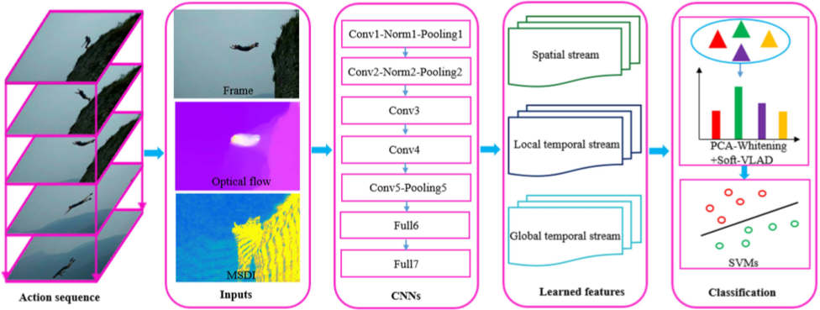
深度双流时空网络
【2016 BMVC】Two-Stream SR-CNNS for Action Recognition in Videos

Slide 37
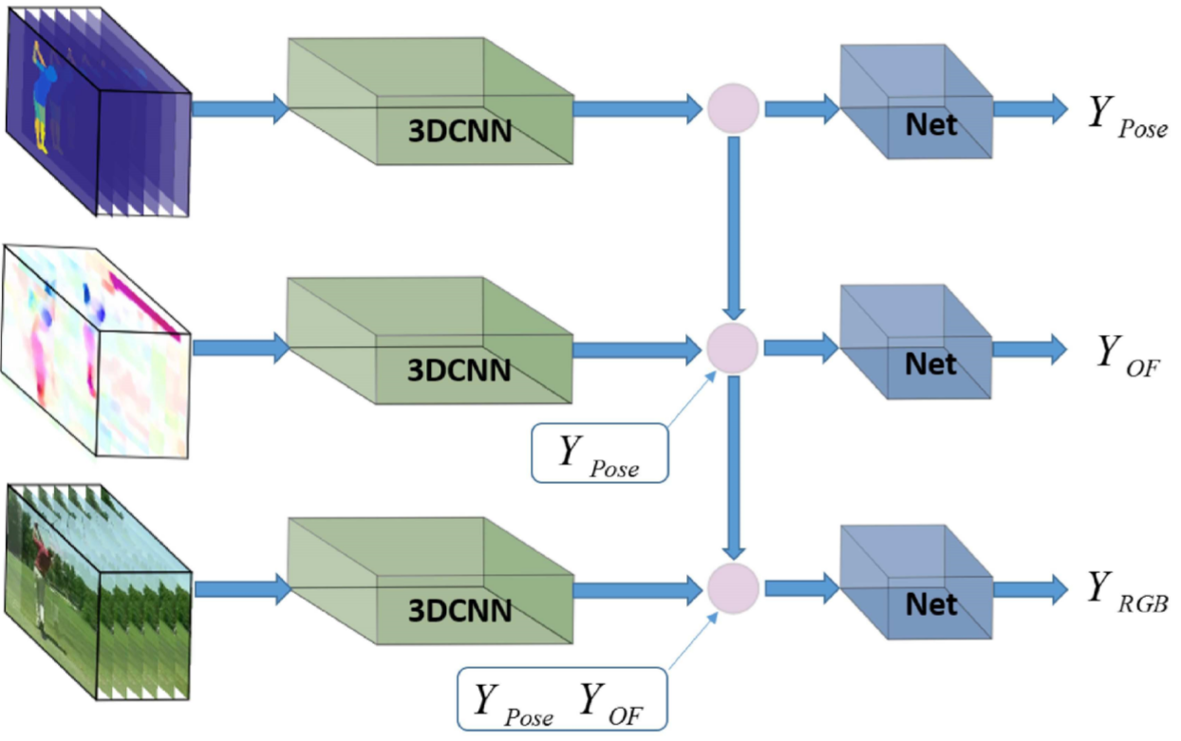
深度双流时空网络
Chained Multi-stream Networks Exploiting Pose, Motion, and Appearance for Action Classiﬁcation and Detection

Slide 38
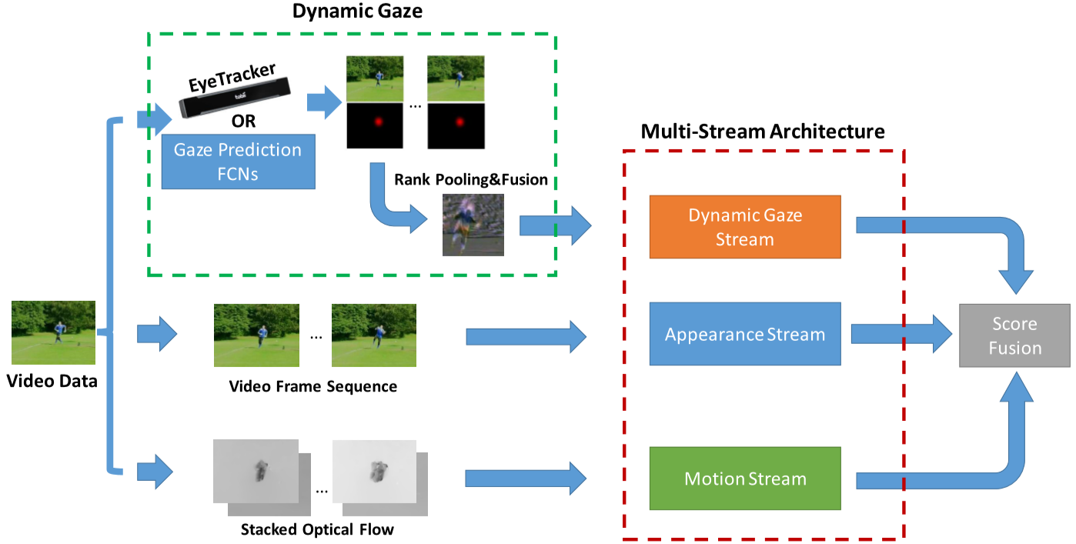
深度双流时空网络
Gaze-Assisted Multi-Stream Deep Neural Network for Action Recognition

Slide 39


深度双流时空网络
A Multi-Stream Bi-Directional Recurrent Neural Network for Fine-Grained Action Detection

Slide 40
深度双流时空网络
思考：有何缺陷？
【2017 arXiv】Hidden Two-Stream Convolutional Networks for Action Recognition

Slide 41

深度双流时空网络
思考：有何缺陷？
拟合光流
【2017 arXiv】Hidden Two-Stream Convolutional Networks for Action Recognition

Slide 42

深度递归时序网络
递归网络

Slide 43
深度递归时序网络
递归网络

Slide 44

深度递归时序网络
长短时记忆 - 递归网络

Slide 45

深度递归时序网络
网络结构
【2015 CVPR】 Beyond Short Snippets: Deep Networks for Video Classification

Slide 46

视频动作检测 - Detection
检测视频中的行为片段，包括开始、结束时间以及类别

Slide 47

视频动作检测
检测视频中的行为片段，包括开始、结束时间以及类别
首尾定义
时间跨度
多个片段
滑动窗 – Sliding Window
行为识别
行为检测
物体识别
物体检测

Slide 48



视频动作检测

Slide 49


视频动作理解
理解视频序列的意义，并用自然语言描述 – Seq2Seq
视频动作理解
视频动作检测
视频动作识别

Slide 50


视频动作理解

Slide 51
Keras实现
数据准备
网络结构
参数选择

Slide 52

实验结果展示 – 特征图
Three Modules (SGMs)：

Slide 53

实验结果展示 – 混淆矩阵

Slide 54


实验结果展示 – 准确率

Slide 55



实验结果展示 – 可视化

Slide 56

实验结果展示 – 实例

Slide 57




实验结果展示 – ODAR比赛

Slide 58


实验结果展示 – 技巧
Tricks:
1、Data Augmentation.
2、Pre-Train on Sports-1M.
3、Video Level (vote).
4、Fusion with Frames.
5、Manually.

Slide 59
参考文献
[1] Andrej Karpathy, George Toderici, Sanketh Shetty, Thomas Leung, Rahul Sukthankar, and Li Fei-Fei, “Large-scale video classification with convolutional neural networks,”in Proceedings of the conference on Computer Vision and Pattern Recognition, 2014, pp. 1725–1732.
[2] Du Tran, Lubomir Bourdev, Rob Fergus, Lorenzo Torresani, and Manohar Paluri, “ spatiotemporal features with 3d convolutional networks,” in 2015 IEEE International Conference Computer Vision . IEEE, 2015, pp. 4489–4497.
[3] Karen Simonyan and Andrew Zisserman, “Two-stream convolutional networks for action in videos,” in Advances in Neural Information Processing Systems, 2014, pp. 568–576.
[4] Christoph Feichtenhofer, Axel Pinz, and Andrew Zisserman,“Convolutional two-stream network fusion or video action recognition,” in Proceedings of the IEEE conference on Computer Vision Pattern Recognition, 2016.
[5] Shuiwang Ji, Wei Xu, Ming Yang, and Kai Yu, “3d convolutional neural networks for human recognition,” in Proceedings of the 27th International Conference on Machine Learning, 2010, pp. 4 95–502.
[6] Hakan Bilen, Basura Fernando, Efstratios Gavves, Andrea Vedaldi, and Stephen Gould, “Dynamic image networks for action recognition,” in IEEE International Conference on Computer Vision Pattern Recognition, 2016.
[7] Lin Sun, Kui Jia, Dit-Yan Yeung, and Bertram E Shi, “Human action recognition using factorized spatio-temporal convolutional networks,” in Proceedings of the IEEE International Conference Computer Vision, 2015, pp. 4597–4605.

Slide 60
在线问答
？
Q&A

Slide 61

感谢各位聆听
！
Thanks for Listening

